Slide 1
Lab 9: Inference for Population Mean
STAT 201: Elementary Statistics
Pre-lab

Slide 2


Slide 3
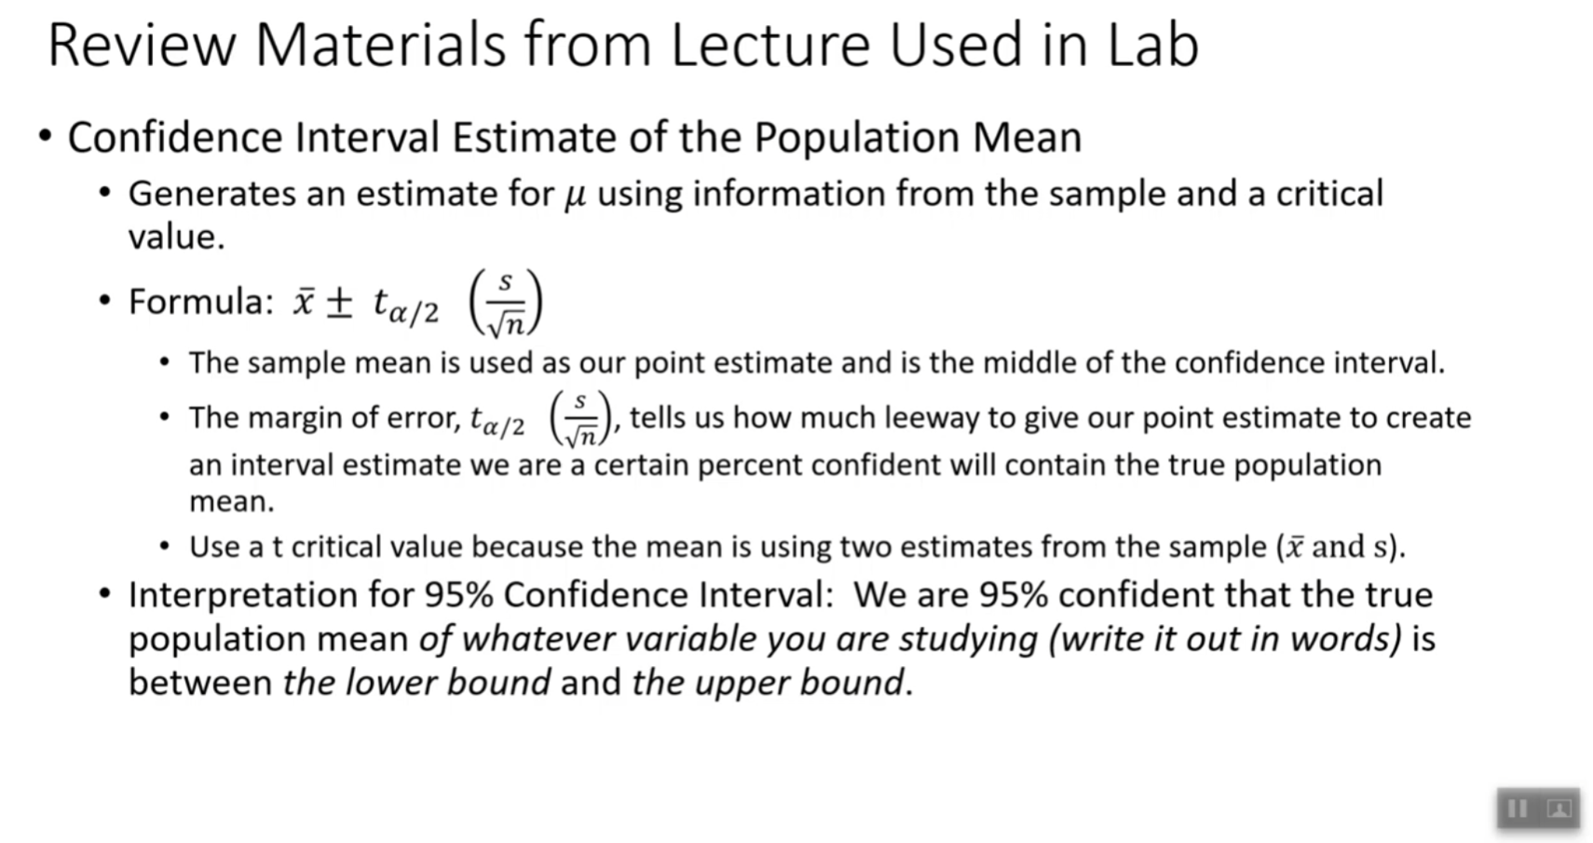

Slide 4
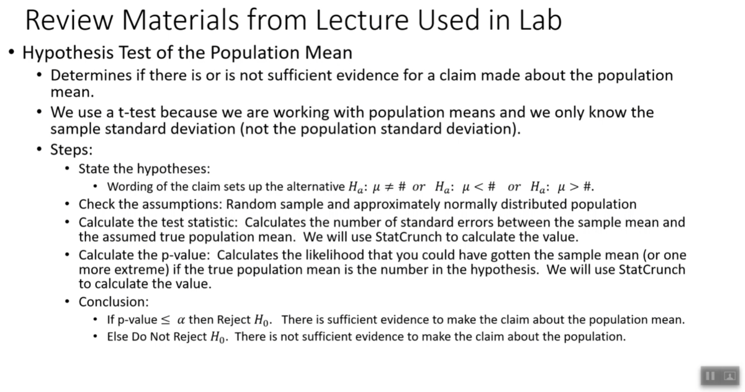

Slide 5
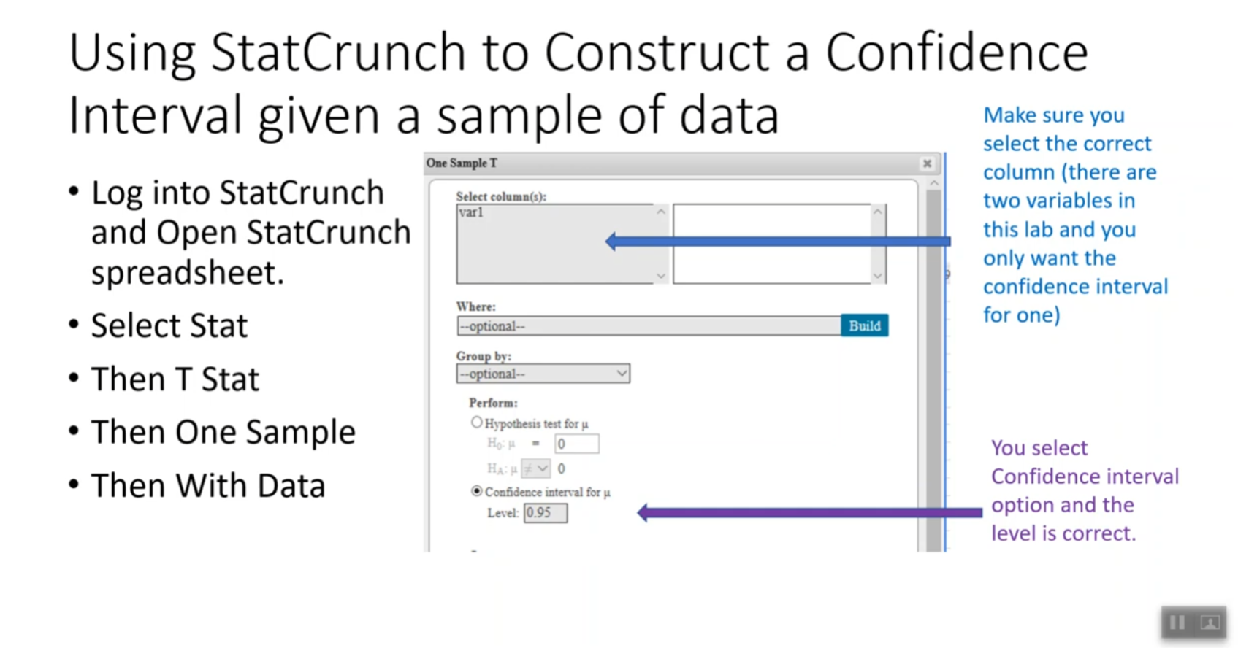

Slide 6
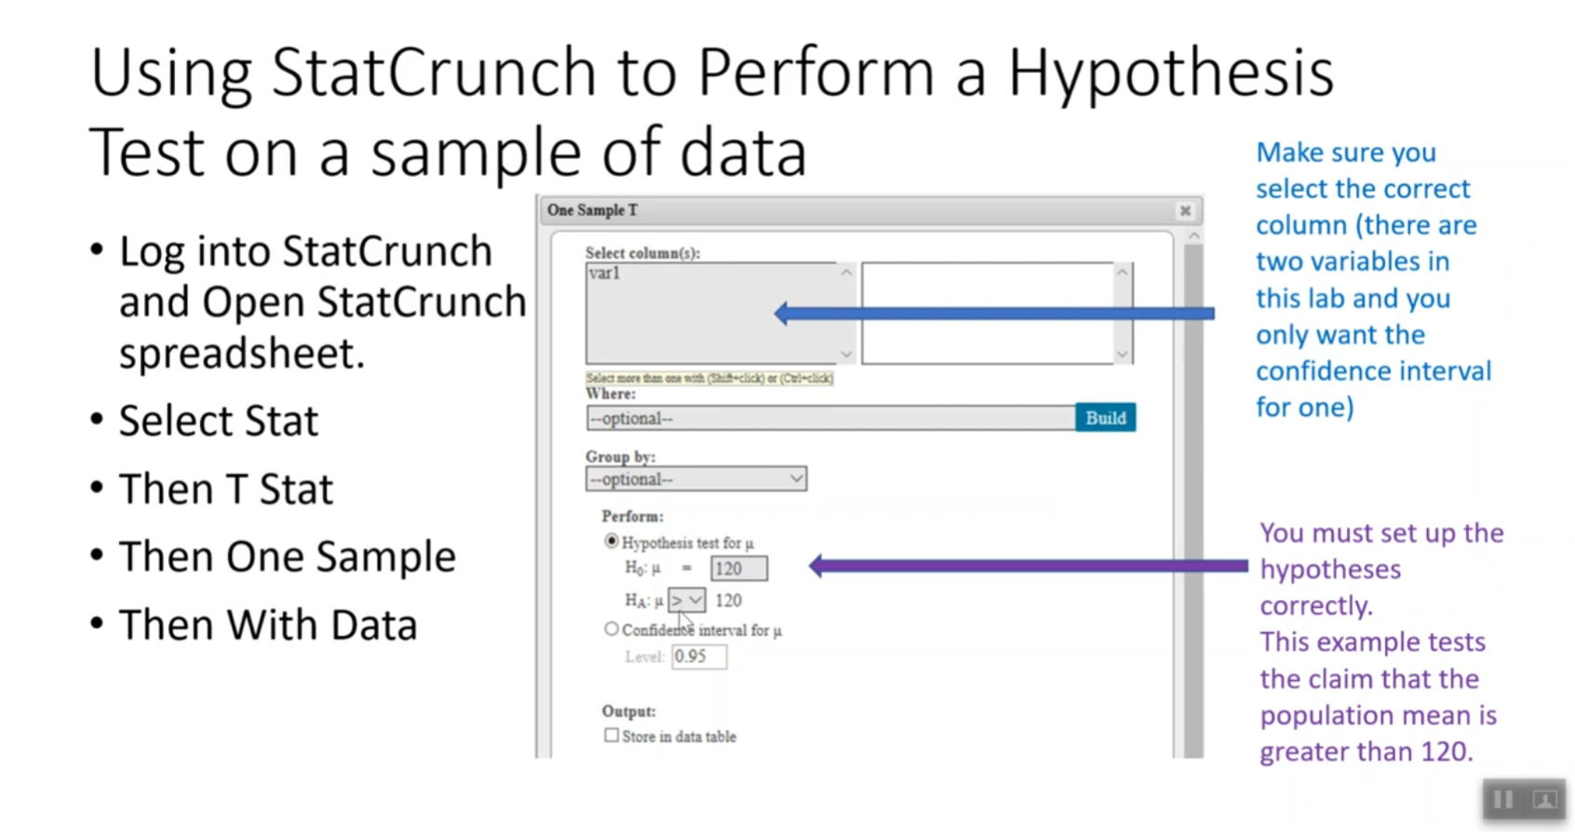

Slide 7
